Slide 1
Educational Administration functions of school Administrators
Chenyue(Cherry) Gaoyongliang(Messi)

Slide 2


1.Plans
——It refers to the planning of future actions or activities and the supply and use of future resources
——It is a means to reduce the uncertainty in the process of resource allocation
——"everything must be done before it can be undone. "

Slide 3
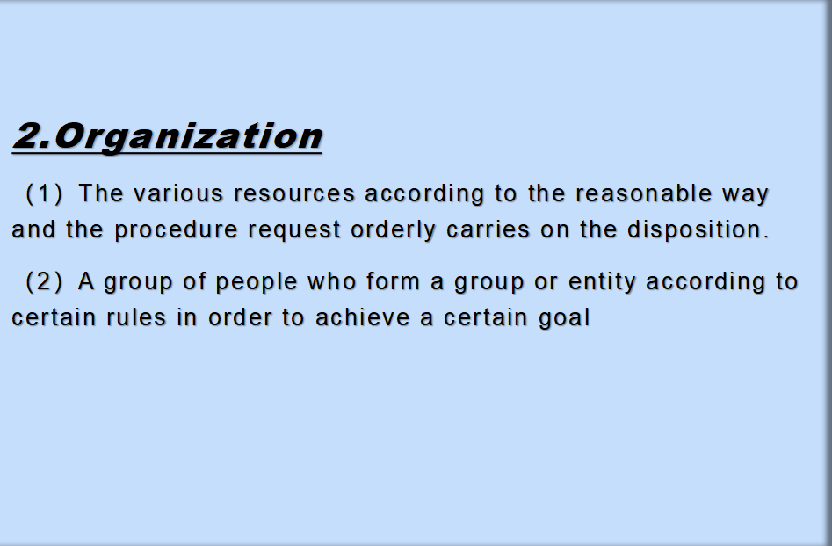

Slide 4
3.Conducting
Definition of command:
A leader (top manager, planner) instructs all people in the organization to work together to implement a plan and achieve the organization's goals
4 features:
(1)Instructions
(2)Mobilizes
(3)Harmonizes
(4)Prodding

Slide 5

4.Harmonizes
Coordination of the definition: refers to the Professional Division of Labor under the conditions of their work in an orderly manner together activities
Coordination is one of the most common and important management tools

Slide 6
5.Control (monitor)
Control is defined as the continuous tracking and revision of actions taken in the direction of the goal and the achievement of the desired outcome or performance, in accordance with the stated goal

Slide 7
An overview of the educational function:
(1)The significance of educational management function
Meaning: The function of the educational responsibility of market value management
Meaning: The explicit function of education management affects the establishment of Education Organization management and the development of education work, and thus affects whether education can effectively improve the quality of education, better human development and society

Slide 8

If schools are to survive, they must be both effective and efficient, says the American education management scholar Sargiovanni. Policies must be implemented, budgets must be prepared, teachers'work must be organized, classrooms must be planned, reports must be completed, standardized tests must be conducted, supplies must be purchased, schools must be kept clean, schools must be free from violence, the classroom must be in order all these things need to be managed to ensure the survival of the school as an organization

Slide 9

ATTRIBUTES OF EDUCATIONAL MANAGEMENT:
---Fundamental attributes of coordinated management.
1.In the middle of the night
2.Coordinate Working Relationships
3.Coordinate personnel relations

Slide 10

CHARACTERISTICS OF EDUCATION MANAGEMENT:
.It is confronted with the object of development and education
.He is confronted with the subjective initiative of human being -- The emotion
.She was confronted with the prospect of working creatively and with a sense of motivation
.He is confronted with the complexity of intellectual human structure

Slide 11
Types of educational management functions of school administrators:
1. Planning Function
2. Rule of lawFunction
3. Oversight Function
4. Business Functions
5. Guidance Function
6. Service functions

Slide 12
1. Planning Function
Refers to the responsibilities and roles of educational administrators in teaching planning.
The plan is divided into two parts: Directive Plan and Directive Plan

Slide 13
2.RULE OF LAW FUNCTION
The function of rule of law refers to the responsibilities and roles of educational administrators in educational legislation and law enforcement.
The function of rule of law is an important function in the formal planning of educational management activities. This is a powerful measure of the mouth of management education

Slide 14
3. Oversight Function
The function of supervision is the responsibility and the role of the educational manager in the educational management.

Slide 15
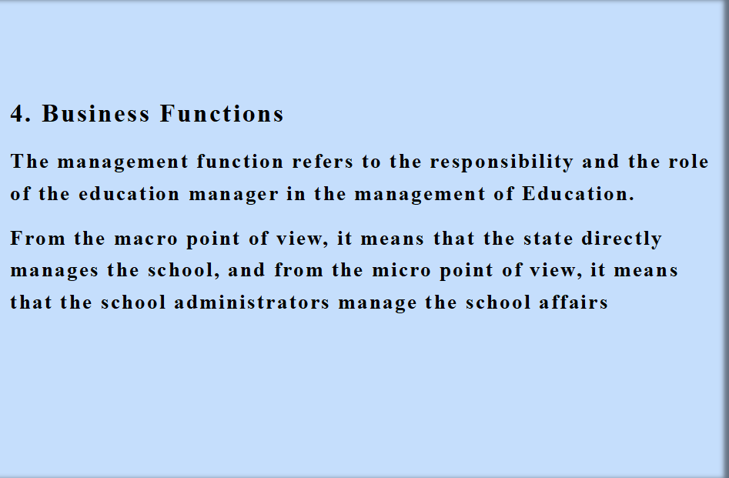

Slide 16
5. Guidance Function
Refers to the responsibilities and roles of educational administrators in the field of educational management, including, on the one hand, the guidance and recommendations provided by the regional educational administration departments of the National Team and schools, on the other hand, it is also included in the management activities within the school, where the manager gives guidance to the person being managed

Slide 17
6. Service Functions
It refers to the responsibilities and roles of educational administrators in the service of education. It includes projects such as state provision of information, resources, and co-ordination of funding for local and school institutions, as well as services provided by school administrators to the regulated

Slide 18
What role the principal should play:
1.Pathfinder
2.Dredger
3.Commander

Slide 19
What is the educational management function of school administrators with Chinese characteristics?
Directing -- supervised

Slide 20
Reference:Chuhongqi《Educational Management and leadership》（Volume two）

Slide 21
THANKS

